Slide 1
Quiz 3

Slide 2
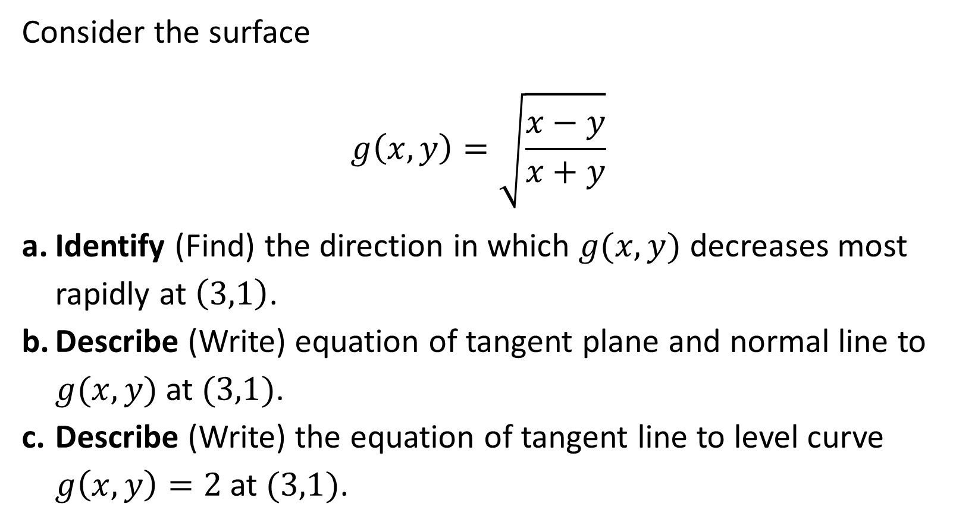
Consider the surface
$$g\left(x,y\right)=\sqrt{\frac{x−y}{x+y}}$$
Identify (Find) the direction in which $g(x,y)$ decreases most rapidly at $\left(3,1\right)$.
Describe (Write) equation of tangent plane and normal line to $g(x,y)$ at $(3,1)$.
Describe (Write) the equation of tangent line to level curve $g\left(x,y\right)=2$ at $(3,1)$.

